Slide 1
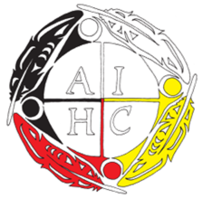
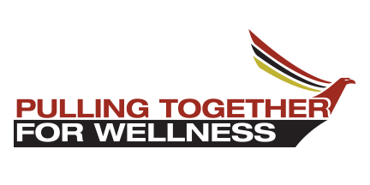
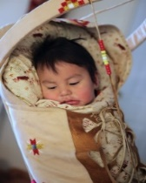
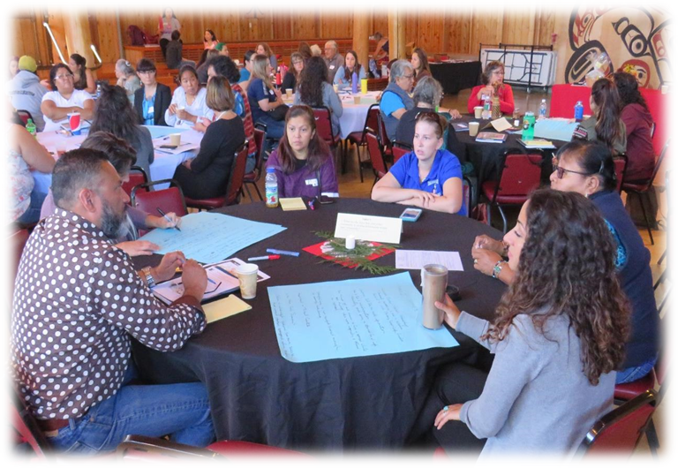
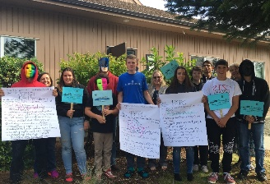
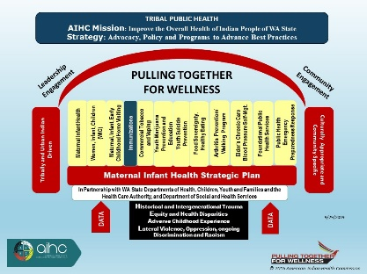
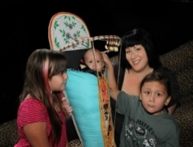
Addressing Immunizations as a Priority Health Disparity
Through Tribally-driven Processes
PULLING TOGETHER FOR WELLNESS
Jan Ward Olmstead, MPA and Wendy Stevens, MNPL, MSS
DISPARITIES
American Indians and Alaska Natives are heavily impacted by illnesses that could be prevented through proper immunizations
AI/ANs experience 70% greater rates of death due to pneumonia and influenza (P/I)
AI/AN elders 65 or older are 20% more likely to die from P/I
2018
Continued Partnerships:
- Group Health Foundation
- Department of Health
- Urban Indian Health Institute
2018 Collaborator Award Recipient, Immunization Action Coalition of Washington
Held annual Tribal and Urban Indian Health Immunization Coalition Meeting
Tribal Leaders Health Summit and resource table and Tribal Health Fairs
2019
Convene and development of THIC Charter, Mission, Vision, and Strategies
Develop PTW Immunizations PSEs
Site Visits and Technical Assistance
Monitoring state legislation, initiatives and outbreaks
Serve as a resource on current Tribal Immunizations issues
Participation in Statewide efforts
COLLABORATIVE VALUES
Address immunizations as a priority health disparity through a Tribal/Urban Indian process that is tribal/community-driven and culturally responsive
2012
Tribal Healthcare Worker Immunization (THIW) survey/assessment
PRAMS Flu Vaccine for AI/AN pregnant women
Tribal Leaders Health Summit - report on initial THIW findings and a decade of tribal immunization progress
2013
THCW Immunization Report
Dissemination of 2013 Report
2014
Adolescent Immunization Project/Report
2013/14 Report Dissemination
2015
Study feasibility of convening Tribal Immunization Summit
2016
Report on Feasibility of Tribal Immunization summit
HPV Native Youth Project
Highlights – 10+ years
Funding Identified—Action: 2008 Top Five Tribal Strategies Identified to address Disease Outbreak
COLLABORATION
Funding Identified Action: 2009
Tribes identified barriers and strategies
Established Tribal Health Immunization Workgroup (THIW)
Provided assistance to Tribes to evaluate and implement immunization strategies & address systems issues (bridge- RPMS/Child Profile)
Identified pilots and resources to increase immunizations rates in a culturally appropriate community-driven manner
AIHC 2010 determinations:
Continue Tribal Health Immunization Workgroup (THIW)
Expand opportunities to meet regionally with access to all AIHC delegates
Activities:
THIW two-year work plan
Identified health care worker immunization rates as key project
Tribal Leaders Health Summit, H1N1/Immunization session
Affordable Care Act competitive grant award: health care workers immunization rates
Centers for Disease Control funded the Tribally-driven project developed by THIW in 2009-10, H1N1 pandemic influenza lessons learned
TRIBAL GOALS
1. Fully immunized population-100%
2. Develop an algorithm; tribally identify five core bases and specify the strategic branches
3. Rapid and timely responses
4. Documentation protocol
5. Notification
2017
Tribal and Urban Indian Health Immunizations Annual Meeting
Determination to build Tribal and Urban Indian Health Immunization Coalition
Seek capacity funding
Integrate Pulling Together for Wellness Strategies
"Tribal/UIHP Health Immunization Coalition Meeting October 7, 2019" by Jan Ward Olmstead and Wendy Stevens
© 2019 American Indian Health Commission
Notes:
Tell the story: 2008 Regional summit 3 states and how we have carried this work forward.
Studies show that American Indians and Alaska Natives are heavily impacted by illnesses that could have been prevented through proper immunizations.
Death rates for pneumonia and influenza in AI/AN populations of all ages were 70% greater than overall US rate of 12.9 per 100,000 population during 1997.
American Indians/Alaskan Natives aged 65 years and older were 20% more likely to die of pneumonia and influenza than the US population as a whole during 1992–1994.
Diabetes has a substantial impact on deaths associated with pneumonia and influenza and AI/AN adults have age-specific prevalence of diabetes 2 to 3 times higher than that for US adults as a whole.
In Washington state, the mortality rate for AI/AN was 1233.6 per 100,000. 71% higher than the rate for Non-Hispanic Whites.
Marc Traeger, Alette Thompson, Elizabeth Dickson, Augustine Provencio, Bridging Disparity: A Multidisciplinary Approach for Influenza Vaccination in an American Indian Community, Am J Public Health. 2006 May; 96(5): 921–925. doi: 10.2105/AJPH.2004.049882, PMCID: PMC1470593
Data Sources: Northwest Portland Area Indian Health Board. American Indian & Alaska Native Community Health Profile - Washington. Portland, OR; Northwest Tribal Epidemiology Center, 2014 (WA State death certificates, 2006-2010, corrected for misclassified AI/AN race.)

